Slide 1
Complex Data EXplorer
Supporters:
DSWG
AMMOS
…and people like you
JPL Confidential
Proposal-Sensitive Material
Know
Thy
Data
CODEX
Dr. Lukas Mandrake

Slide 2
A Common Need
Dr. Lukas Mandrake, Jack Lightholder

Slide 3
A Common Need
Model generates 1M potential mission trajectories w/ dozens of fitness metrics
Do the trajectories fall into families with similar behaviors?
How many such families are there?
What are the uniquely identifying characteristics of each family?
Model Output
Dr. Lukas Mandrake, Jack Lightholder
1

Slide 4
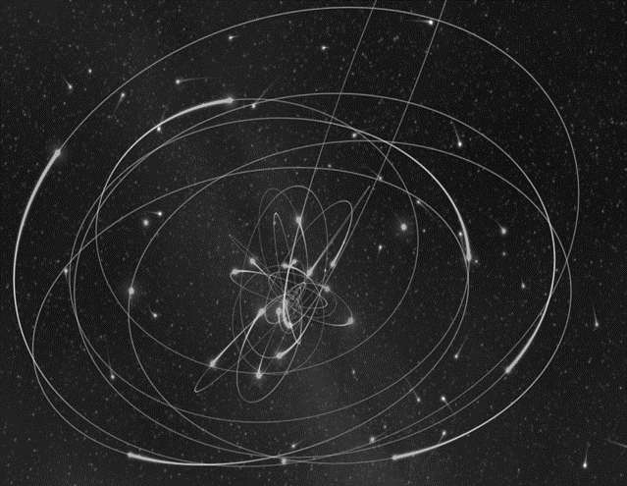
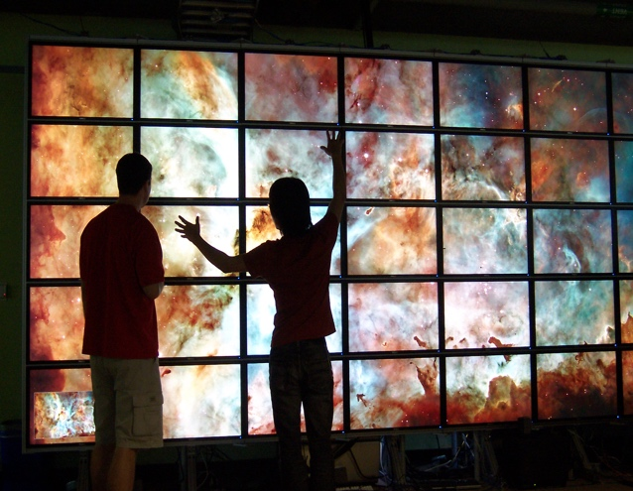
A Common Need
New OCO-2 data release. 10M soundings. Validation team needs to sign off.
Does this version of the retrieval code match past behaviors?
If not, where & when do they differ?
What key atmospheric conditions correlate with the mismatch?
Science Data Systems
Dr. Lukas Mandrake, Jack Lightholder
1

Slide 5
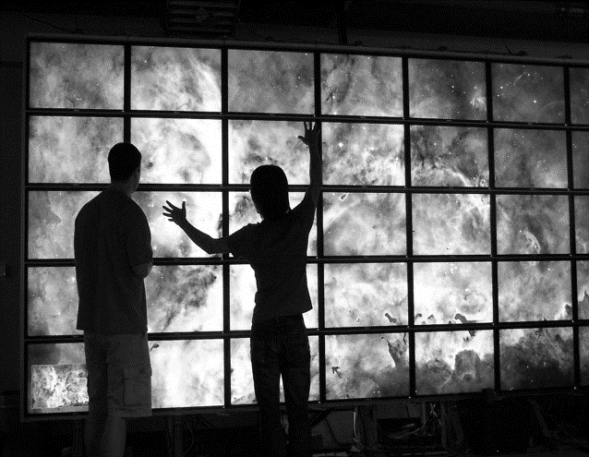
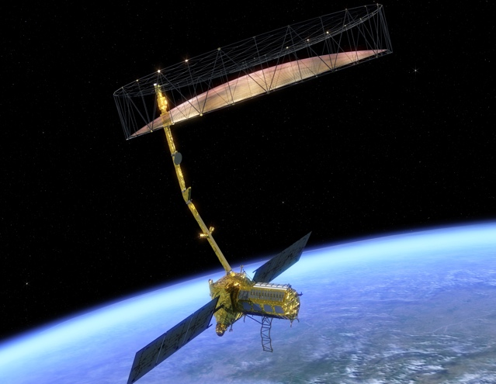
A Common Need
Hardware fault just occurred onboard! Need to find root cause ASAP.
Does the pre-fault telemetry show any differences vs. the past?
If so, what are the key telemetry channels or science products to examine?
What times in the past looked similar to the pre-fault state?
Rapid hypothesis forming, testing, falsification
Anomaly Response
Dr. Lukas Mandrake, Jack Lightholder
1

Slide 6
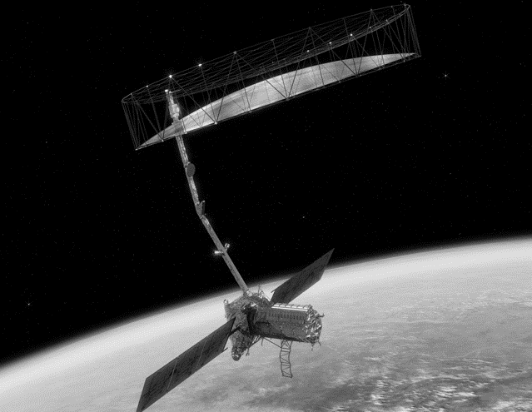
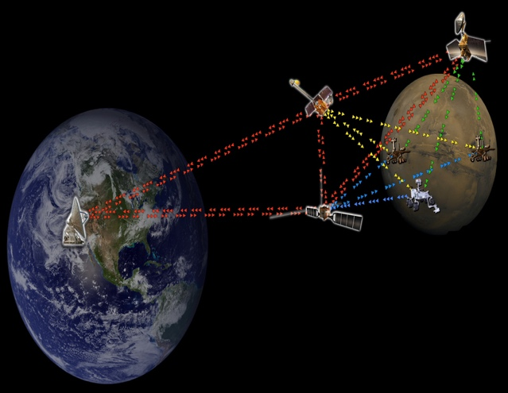
A Common Need
Signal lock to an active mission was just lost unexpectedly… again
How unusual is this event given the past mission experience?
What were the most unusual readings in signal metrics before loss?
Are there trends in losing lock? What do they depend on?
Network / DSN
Performance
1

Slide 7
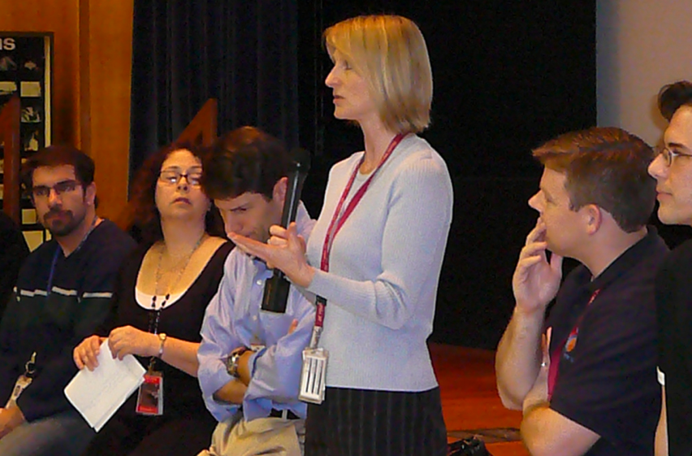
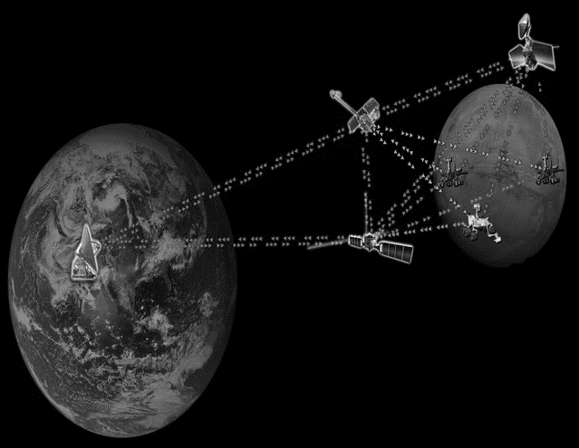
A Common Need
New science data just arrived… is it high priority?
Compare to past findings… how unusual is it?
Compare to targets of interest… is it similar?
Do the expected correlations and relationships hold?
Operations Science Lead
1

Slide 8
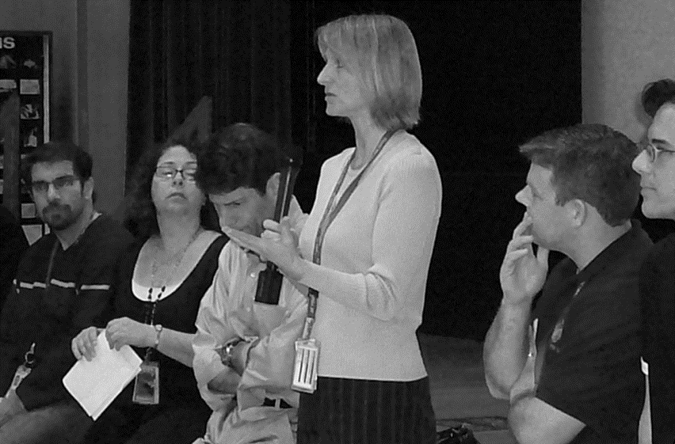
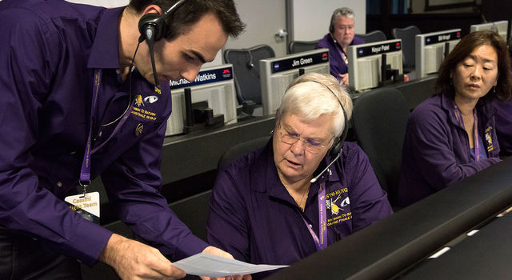
A Common Need
Regular, prolific telemetry arrives daily
Any likely problematic values?
Are co-varying trends as expected?
If oddities appear, which channels and times?
Payload Downlink Lead
1

Slide 9
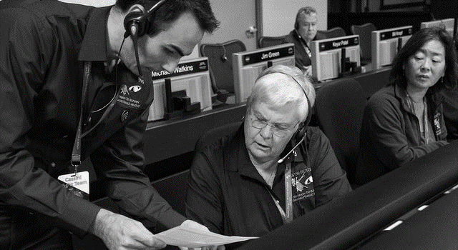
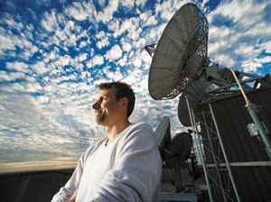
A Common Need
Interesting phenomenon found! But data is too big…
Find more events like this… where, when?
What’s simplest “recipe” to find these events?
Select them out of the data for later analysis
Earth Science
1

Slide 10
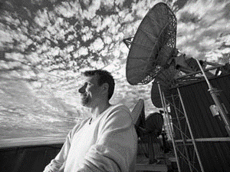
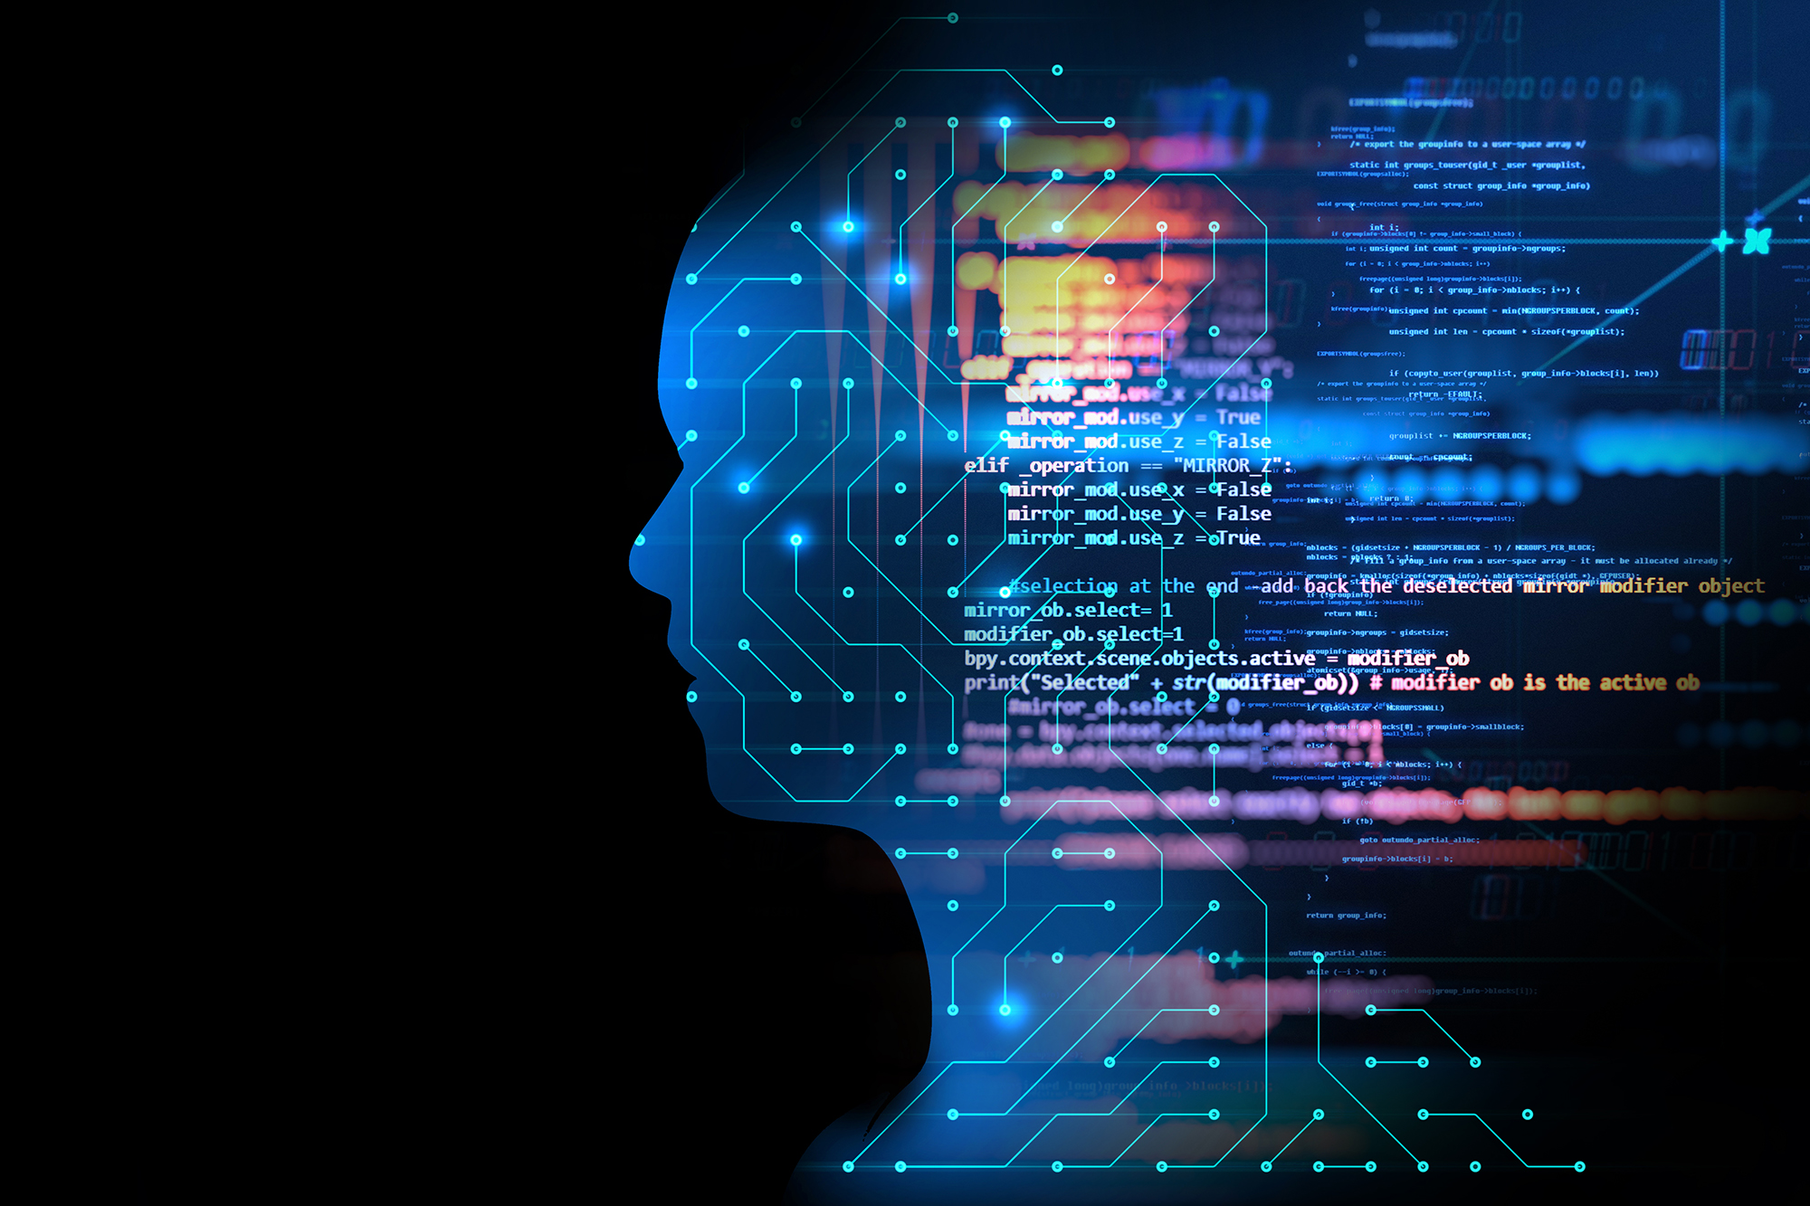
A Common Need
“Take a look at my data and see what you think.”
Any troublesome issues? High correlation? Sparsity?
Perform quick modeling and make trial products
Try out many technologies to find good matches
Sanity check expected behavior & provide feedback
Data Science
1

Slide 11

A Common Need
High Dimensional time-series data
Identify strange, outlier, or invalid values
Interactively explore data
Build/falsify hypotheses
Interrogate relationships between cols
Find more events like this
Provide simple recipe to recognize events
Create predictive, explanatory models
How many families of data are present?
Machine Learning was made for this!
1

Slide 12
Current State of Art
Dr. Lukas Mandrake, Jack Lightholder
1

Slide 13
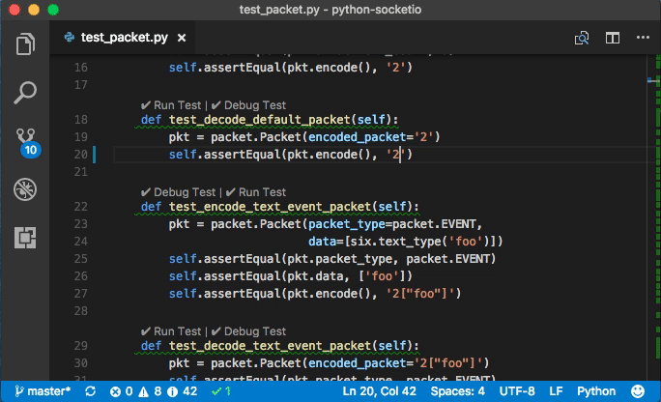
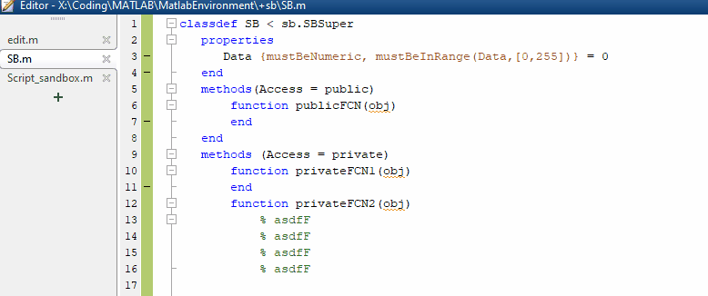
Current State of the Art
Python, Matlab, R scripts… lots of them
Great for routine processing / checking known issues
Very inefficient for exploration
Did you search for all potential problems?
Did you verify all assumptions?
Did you thoroughly visualize your entire data?
Of Course not!
Dr. Lukas Mandrake, Jack Lightholder
2

Slide 14
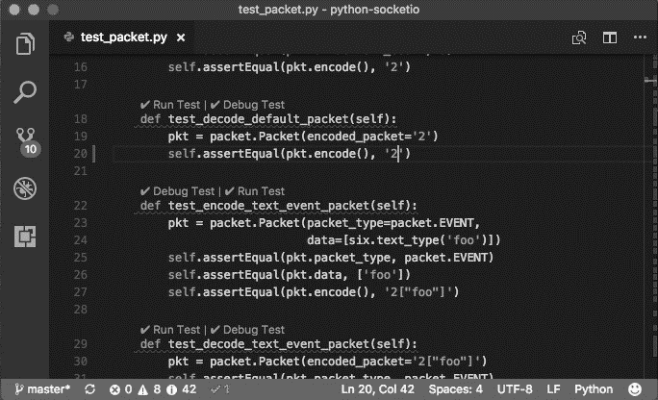
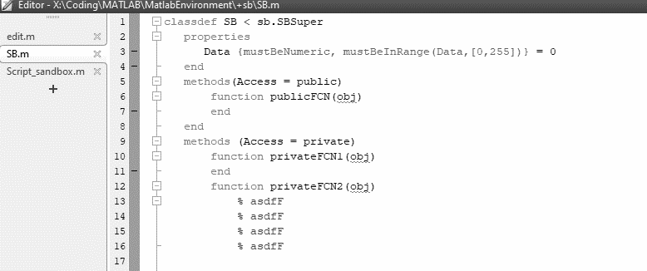
New Concept
X
Don’t fuss over buggy code
Interactively graph and explore
Beautiful interface to many ML approaches
Tools to address the Common Need
Writes the code for you afterwards!
Dr. Lukas Mandrake, Jack Lightholder
2

Slide 15
CODEX
Dr. Lukas Mandrake, Jack Lightholder

Slide 16
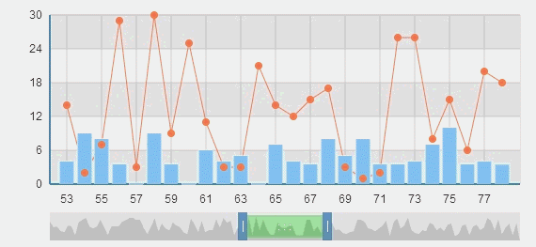
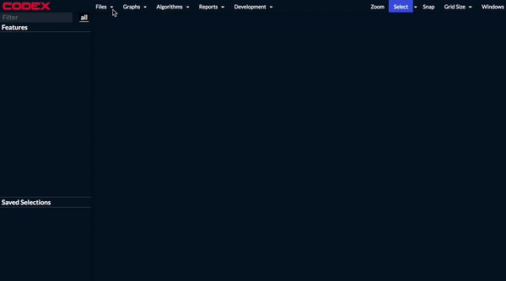
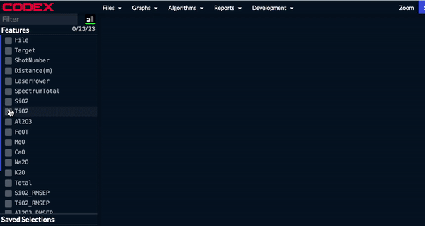
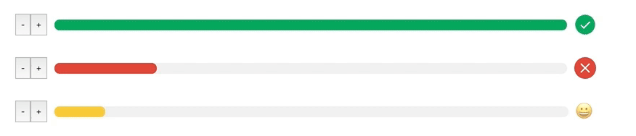
Guiding Principles
Easy, interactive graphing - scatter, heatmap, histogram, line, bar - linked: data here can be found everywhere else
Continuous, visual guidance - No question without rich support to guide answer - No obscure numbers; permit visual selection & previews
Fast interactivity - Humans learn best by manipulating and studying: playing - Slow batch analyses lose context & attention…
Never stop working - Long analyses run in background - Always foreworn of time & memory needs for all choices
Dr. Lukas Mandrake, Jack Lightholder
3

Slide 17
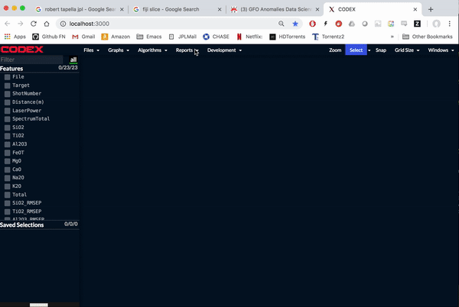
Initial Data Scan
Easy: NaN’s and Inf’s
Moderate: Sigma-outliers
Subtle: Repeated values
Which rows/columns affected?
Just some bad rows to filter? Bad columns?
“Sweep” thresholds to observe effects
(actual footage)
Dr. Lukas Mandrake, Jack Lightholder
4

Slide 18
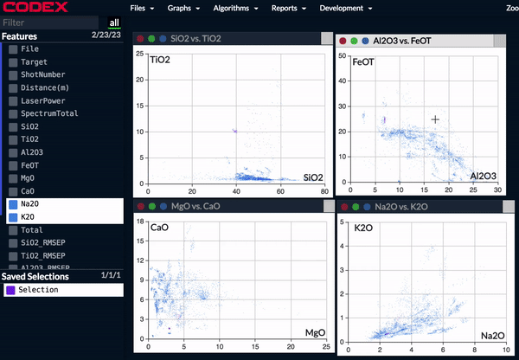
Interactive, Linked Graphs
Make discoveries just by selecting data in a graph
“I wonder what this group of data means?”
Rapidly prove / falsify hypotheses
Simple concept / “Wow!” factor to researchers
Perfect example of discovery through play
Will be extended to all graph types
Dr. Lukas Mandrake, Jack Lightholder
5

Slide 19
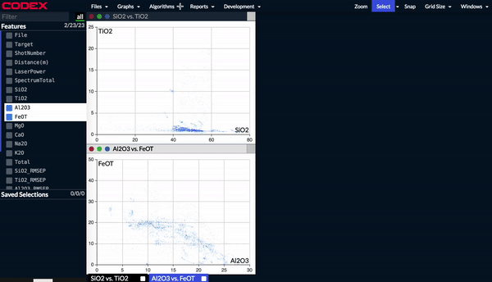
How Many Kinds? (Clustering)
Can’t plot everything vs. everything else…
Automatic search for interesting groups
Perfect example of visual guidance
Focus-of-attention tool
Dr. Lukas Mandrake, Jack Lightholder
6

Slide 20
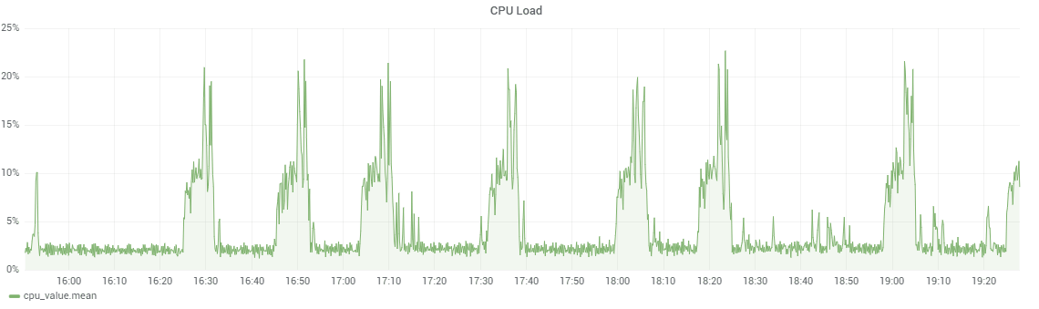
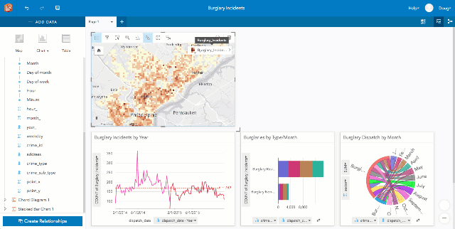
Find More Like This (Interactive Classification)
Starts with examples of desired events
Brush them in time: positive label
Brush undesired regions: negative label
Classify remainder of time as (un)desired
Interactively modify “mistakes” to refine
Finish with potential events & trained model
(notional, not yet implemented)
(notional, not yet implemented)
Dr. Lukas Mandrake, Jack Lightholder
7

Slide 21
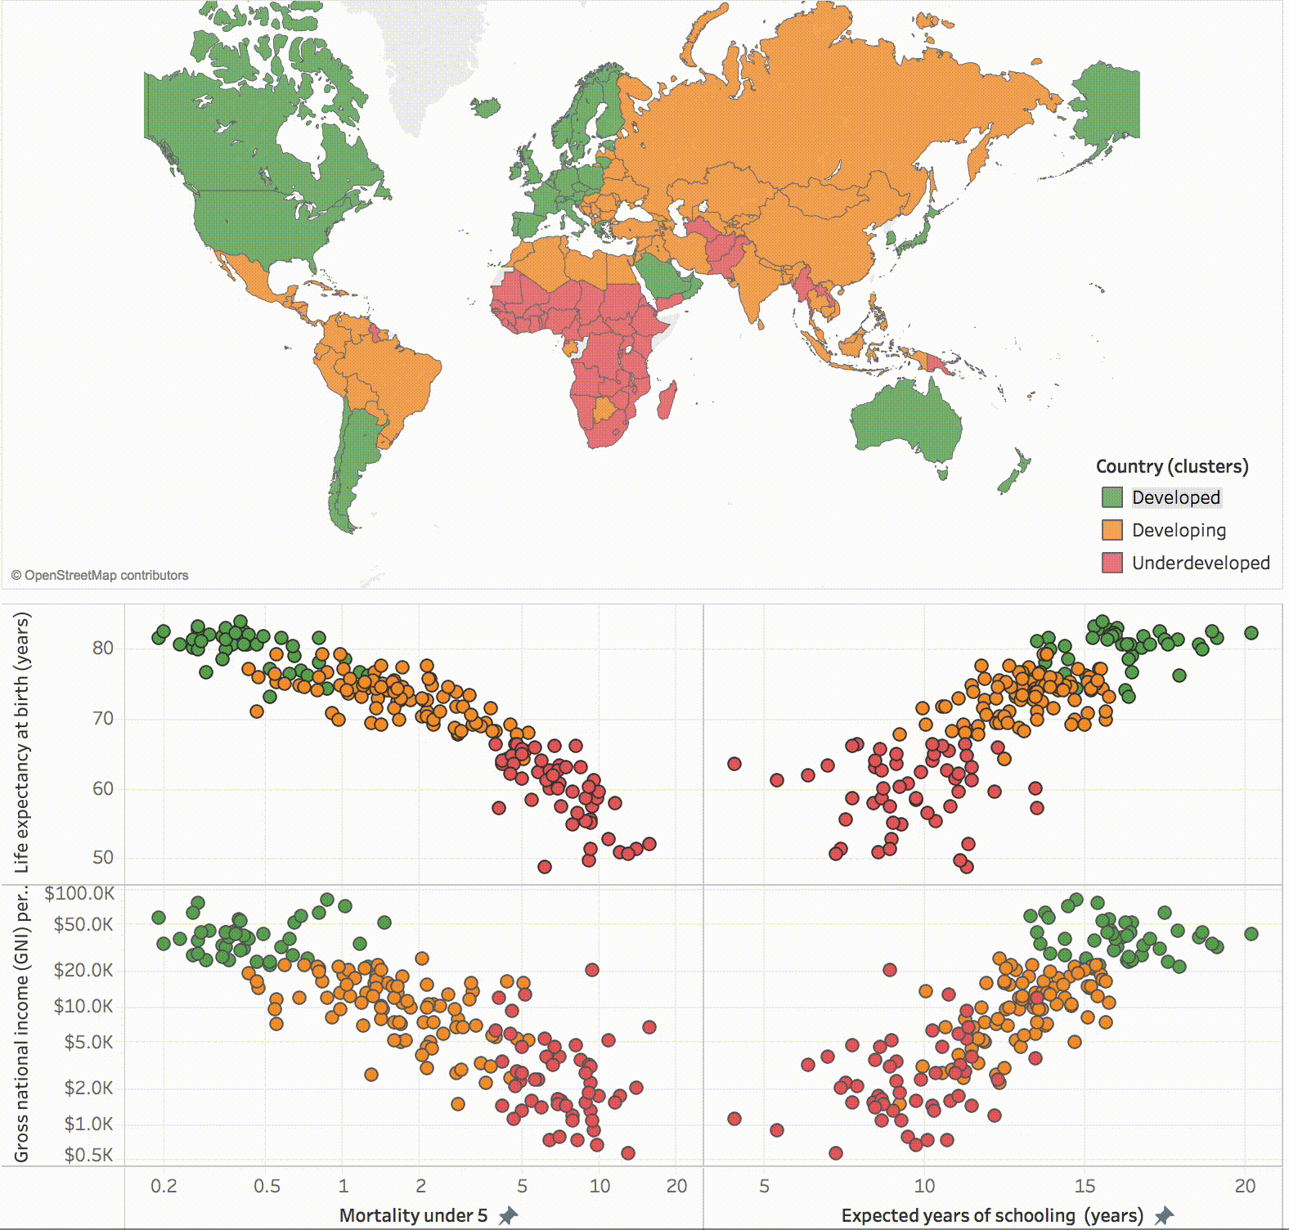
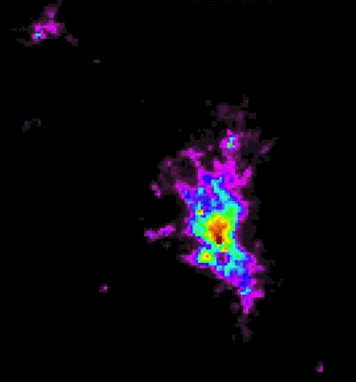
Explain This (Feature Selection / Endmembers)
Starts with subsets of interest - clustering or user-selected
What columns best explain what’s special about one group vs another?
If all data in this subset were made up of a linear mixture of N samples, which N best explain the data?
For each sample, what mixture of these endmembers is required?
(notional, not yet implemented)
(notional, not yet implemented)
Dr. Lukas Mandrake, Jack Lightholder
8

Slide 22
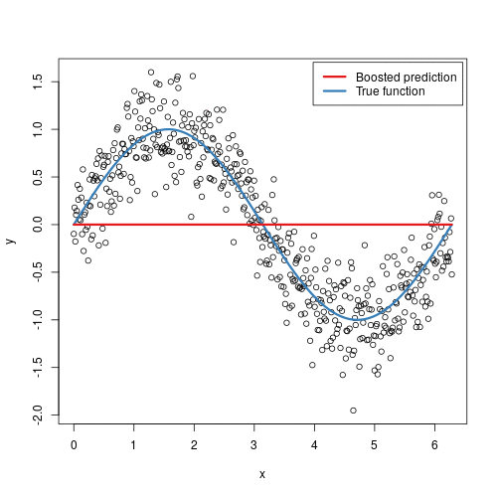
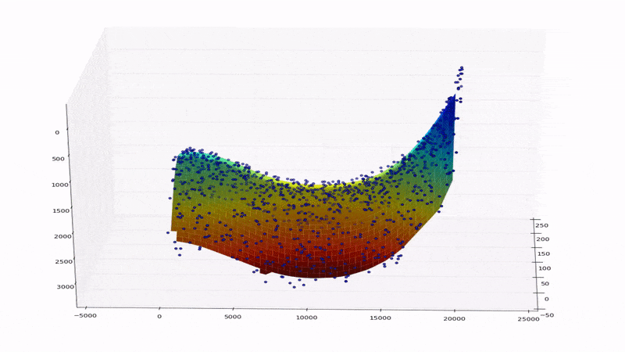
Predict This (Regression)
(notional, not yet implemented)
Predict one column using others
Simple: multivariate curve fitting
Complex: Model-free ML regression
Which columns proved most useful?
What % variance explained for each?
(notional, not yet implemented)
Dr. Lukas Mandrake, Jack Lightholder
9

Slide 23
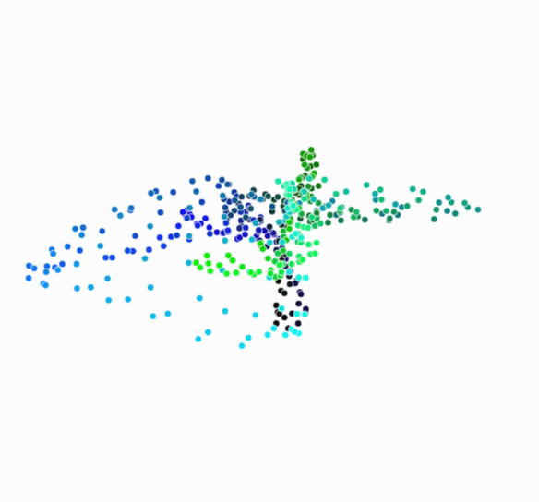
Remove Correlations (Dim Reduction)
Never need all the columns
Because Physics exists, there are relationships between
Find smaller set of new columns
Can reveal essential relationships between original columns
Graphs even hard-to-visualize datasets
(notional, not yet implemented)
Dr. Lukas Mandrake, Jack Lightholder
10

Slide 24
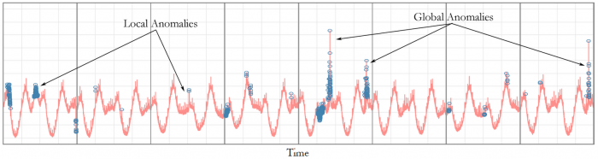
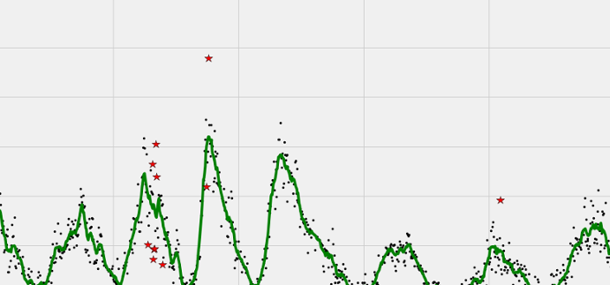
Find Strange Things (Anomaly Finding)
(notional, not yet implemented)
Starts with “normal” times
Detect likelihood of normalcy elsewhere
Least normal regions are anomalies
Focus of attention for further investigation
(notional, not yet implemented)
Dr. Lukas Mandrake, Jack Lightholder
11

Slide 25
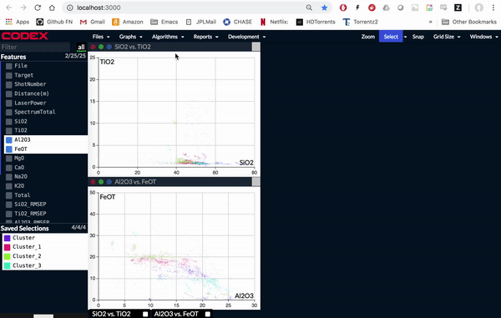
Don’t just explore: Get a Coding Head-Start!
Everything user does is generating Python code!
Can just “export” code to a file at the end
User just picks up in Python and continues deeper analysis
Unprecedented support & time savings
Dr. Lukas Mandrake, Jack Lightholder
12

Slide 26
CODEX: Know Thy Data
Fast discovery of data issues & problems
Fast intuition building
Powerful ML techniques made visual
Guidance for every step of exploration
Doesn’t replace Python or Matlab
Does start you off ready to do great work

